Slide 1
Welcome to
Yorkshire Independent
Roof Training Group
Annual General Meeting

Slide 2
Annual Report 2009 - 10
Denise Cherry
Training Officer

Slide 3
Companies Supported
Increase in member companies by 5% to 105
Number of Supported companies rises from 25% to 35% of Membership
Doubled the network of supportive associate members.

Slide 4
Group Subsidised Short Courses
Asbestos Awareness
Working at Heights
PASMA
Manual Handling
Leadwork
Average course cost £30
13 Companies
86 Learners
300+ hours of learning

Slide 5
Management Courses with Funding Assistance
Site Management Safety Training Scheme
8 Learners
NVQ Level 4
6 Learners
Investors in People
Customised Management Training

Slide 6
Promotions
Roof Overview
YIRTG Newsletters
Apprentice Promotions
Local, Regional and National Networking

Slide 7
Apprenticeships
Consideration of Group Training Association Status
Promotions through Connexions
120 Enquiries
Open Day
Company Introductions

Slide 8
Sourcing Strategic Funding
Working with Training Providers
Second Level 2 NVQ Courses Part Funded
  Enables companies to demonstrate true multiskilling.
Funding for Heritage NVQs

Slide 9
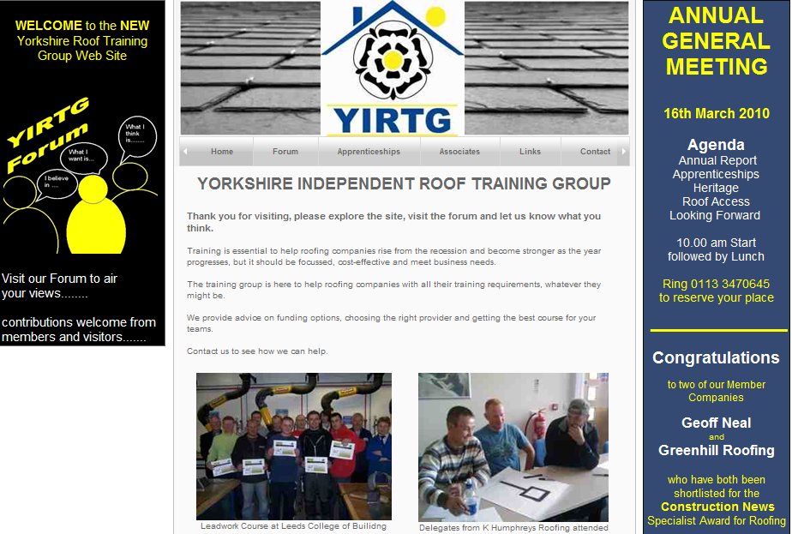
New Website

Slide 10


